Slide 1


Lecture 6
Programming Parallel Computers
Lectures:Prof. Janusz Kowalik
Laboratory:
Mgr.Puzniakowski
University of Gdansk
October 7-25,2013

Slide 2
Part 6
MPI
Communication
Grouping data for communication
A) Vector construct
B) Contiguous construct
Key terms

Slide 3
Communication
Cost of communication
Grouping data to reduce communication
Count Parameter
Derived Data Types
Summary discussion
Communication between processors is the major reason for slowing down cluster parallel computing!

Slide 4
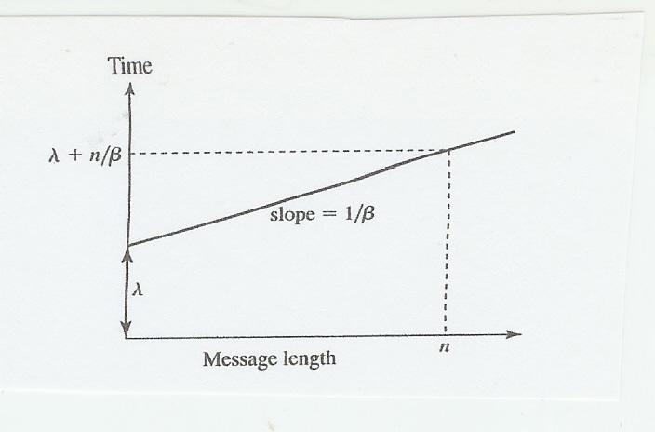
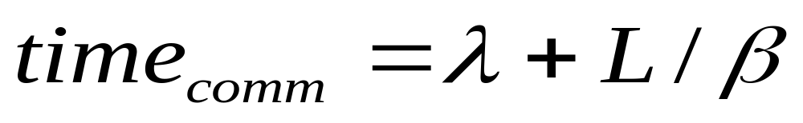
The cost of communication
Please, remember this equation
Latency
Bandwidth

Slide 5
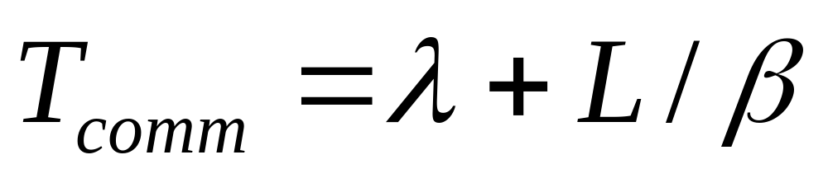
continued
Where L is the MESSAGE LENGTH in bytes
lambda is the LATENCY time and
beta is BANDWIDTH of the network.
In general it is better to send a
larger group of data than many
individual items.

Slide 6
Grouping data for communication
To minimize communication in parallel programs MPI provides two mechanisms for grouping individual items into messages:
1. the count parameter
2. derived data types
struct
vector
contiguous.

Slide 7
Grouping by the count parameter
The functions: MPI_Send, MPI_Recv, MPI_Bcast and MPI_Reduce all have a
count parameter
Two conditions must be satisfied:
1 Grouping the same basic data type.
2. Elements are stored in contiguous
memory locations.
For example : a matrix rows are OK for grouping but matrix columns are not

Slide 8
English terminology
CONTINUOUS : function ,for every two points there is a middpoint in between.
For example: the linear function f=a*x
is continuous between x=0 and x=1.
CONTIGUOUS: locations in memory
Elements located next to each other
For example: elements of vectors or matrix
rows in C/C++ , FORTRAN languages.

Slide 9
Using the count parameter.
Example.
int p;
int my_rank
/* initialize float vector[100] in process 0. */
If (my_rank==0) MPI_Send( vector+50,50, MPI_FLOAT,1,0, MPI_COMM_WORLD);
else (if there are only two processes)
MPI_Recv(vector+50, 50, MPI_FLOAT,0,0, MPI_COMM_WORLD);
alternatively MPI_Send(vector[50],50,……..)

Slide 10
Using the count parameter
Suppose we want to send the third row of a 10x10 matrix A.
The elements of the row are identical type and stored contiguously.
if (my_rank==0) MPI_Send(&A[2][0],10,MPI_FLOAT,1,0,
MPI_COMM_WORLD);
else
MPI_Recv(&A[2][0], 10 , MPI_FLOAT, 0,0 ,
MPI_COMM_WORLD);

Slide 11
Using count parameter
In C/C++ the elements of a 2D array rows are contiguous in memory. We used count=10 for grouping the components of the third row.
The first element of the third row is A[2][0]

Slide 12
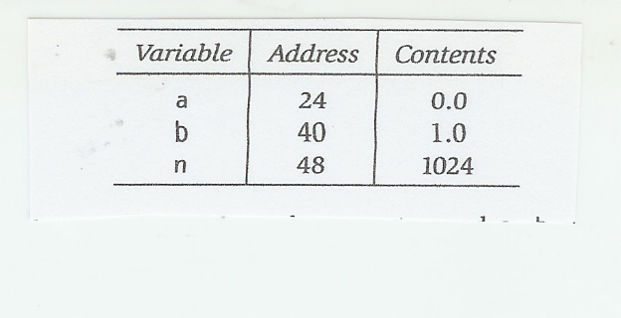
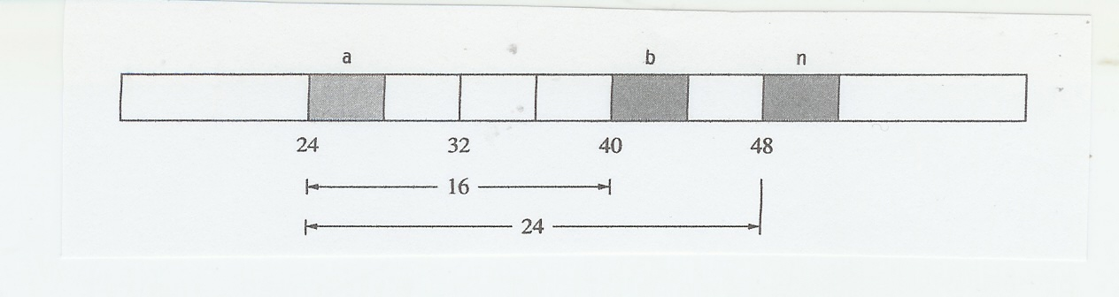
Mixed type items
Suppose that now we need to send three items:
float a,
float b,
int n.
They are not of the same type
and are not stored contiguously in the memory.
Memory layout with displacements

Slide 13
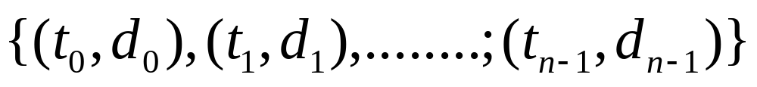
General type or derived datatype.
The most general type or derived datatype is a sequence of pairs:
Where t is a simple datatype and d is a displacement
{(MPI_FLOAT,0),((MPI_FLOAT,16),(MPI_INT,24),}
This derived data type is called struct.
Before using the new datatype we must call the commit
function. MPI_Datatype_commit(MPI_datatype*new_mpi_t)

Slide 14
Other derived datatype constructors
MPI_struct is the most general constructor in MPI. The user must provide a complete description of each element of this this type.
We now limit ourselves to constructing MPI datatypes out of elements of arrays
whose elements are contiguous in memory.
We will consider derived data types :
Vector
Contiguous
Indexed

Slide 15
Vector constructor
Now we want to send the third column of A. The elements are not contiguous in memory but are equally spaced.
This MPI datatype is called the vector
MPI_Type_vector ( count, block length, stride,
element type, new_mpi_t)
MPI_Type_vector(10,1,10,
MPI_FLOAT,&column_mpi_t);
A[0][2]
A[1][2]
Stride = how far
two elements are apart.
Stride 10

Slide 16
Vector construct
Derived data type vector
Syntax
MPI_Type_vector(10,1,10,MPI_FLOAT,&column_mpi_t);
count
stride
block length
Notice: the column of a matrix of size 10x10
is different from the column of size 11x11.

Slide 17
Sending the new type
Before using the new datatype we need to call the function called commit.
MPI_Type_Commit(MPI_Datatype*column_mpi_t);
if (my_rank==0)
MPI_Send ( &A[0][2],1,column_mpi_t, 1,0, MPI_COMM_WORLD);
else
MPI_Recv(&(A[0][2[,1, column_mpi_t,0,0, MPI_COMM_WORLD);
A single column
The newly
defined type

Slide 18
Contiguous constructor
MPI_Type_contiguous( count,
MPI_Old Datatype,
MPI_Datatype (new type));
In type contiguous one simply specifies that the derived type new_mpi_t consists of count contiguous elements ,each of which has type old type.
This construction may be complex and involve previously constructed new types.!!

Slide 19
Contiguous constructor and use
Equivalent communications:
MPI_Send (buffer, count, datatype , dest, tag , comm)
The same as:
2. MPI_Type_contiguous (count, datatype,newtype)
MPI_Type_commit(newtype)
MPI_Send( buffer, 1,newtype,dest,tag,comm)
The second alternative is longer but now we can use newtype for collective communications.

Slide 20
continued
Example.
Using the contiguous constructor , we can ,for example ,construct a new data-type by combining several rows of a matrix.
The new data type can be several consecutive rows.
This may be useful for Scattering matrix by multiple rows.

Slide 21
An exercise
Assume that Process 0 has an 8x8 matrix A whose elements are integers.
Construct the derived new data type that
is a double row of A, and call it double_row.
Broadcast the last two rows of A .
(Send the last two rows to all processes.)

Slide 22
Indexed
In MPI_Type_indexed ,the derived type consists of count of elements of old_type.
The ith element consists of block length [i] and is displaced from the beginning (displacement 0) by the displacement [i].
Note that displacements are not in bytes.

Slide 23
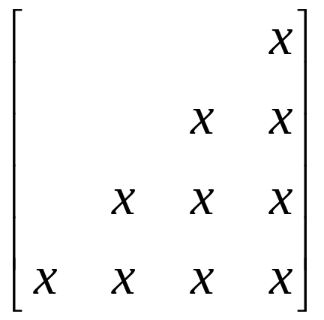
Indexed constructor
Example.
Suppose we want to send the lower-triangular part of a square matrix. The blocks are equally spaced ,(n-1) positions apart but are not of equal length!!
The distances between blocks are equal (2)
but the block lengths are not equal.
(2)

Slide 24
Which method to use.
1. If the data to be sent is stored in consecutive entries of an array then one should simply use the count and datatype parameters to the communication functions.
2. More complex cases may require MPI_Type_contiguous.

Slide 25
Which method to use
3. If the data is of the same type and stored at regular intervals then constructing derived types will be likely most efficient.
4. It is important to remember that using collective functions is always preferable over multiple Send and Receive.

Slide 26
Summary discussion
The main purpose of grouping data for communication is to reduce the time of communication.
The second purpose is creating new data types that are convenient for collective communication such as scattering, broadcasting or gathering.
We should keep in mind that grouping data operation also takes time.
No MPI operation is free.
THE GOAL IS PERFORMANCE!!

Slide 27
Small versus large problems
1.For small problems performance is not essential
For large problems performance is very important
We may need to apply different algorithms
for identical problems of different sizes.
For large problems we must use efficient
solution methods.

Slide 28
What is an efficient algorithm?
Low computational complexity
T(n)=polynomial but not exponential function of problem size n.
Low communication overhead.
Low required memory.
Mlow span(short critical path).
Local data access.

Slide 29
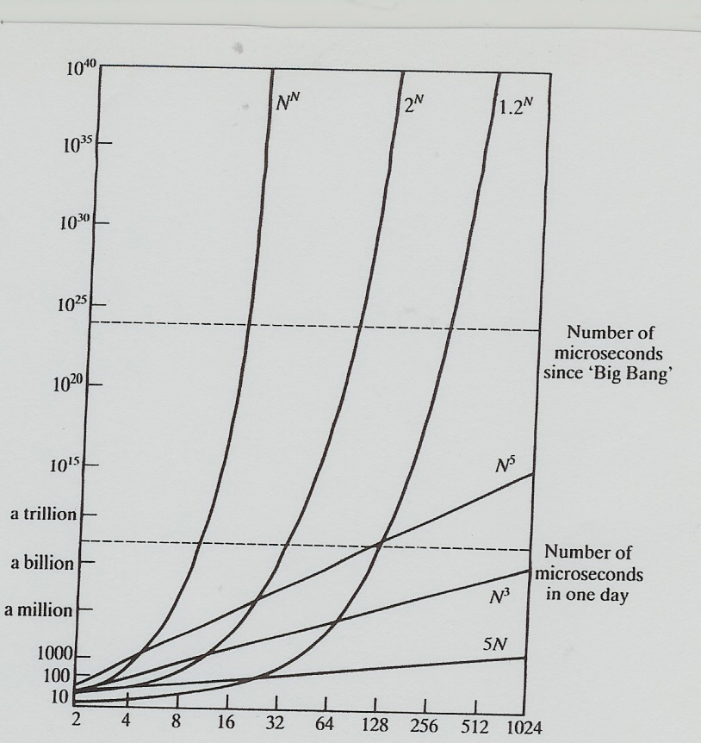
Polynomial and exponential functions
Exponential amount of
Required computing resources limits our ability of solving large problems.

Slide 30
Key Terms
Communication latency
Bandwidth
Commit
Count parameter
Vector derived data structure
Contiguous derived data
Indexed derived data
Struct
Computational complexity
Memory complexity

Slide 31
Used English terms
Elements stored contiguously
How many memory locations apart
Grouping data for communication
Grouping data to minimize the
communication time
Latency
Communication bandwidth

Slide 32
Von Neumann bottleneck
Memory access is a computer bottleneck.
Processor speed was for a long time increasing exponentially
Memory access speed linearly.

Slide 33
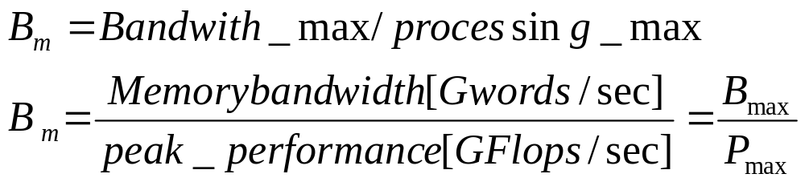
Assessing performance I
An important balance ratio
Modern microprocessors are unbalanced
Hence the bandwidth is the main limiting
factor for performance.

Slide 34
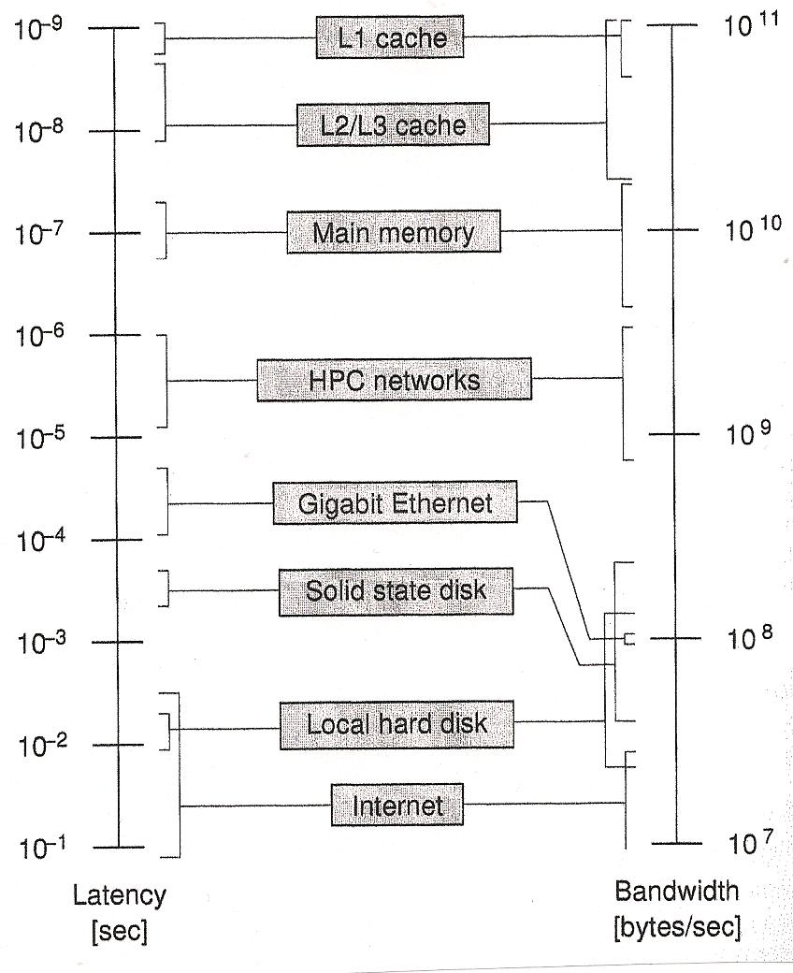
Optimizing performance II
Latency and bandwidth
for data transfer.
Registers are omitted
since their speed
matches the speed of
processing.

Slide 35
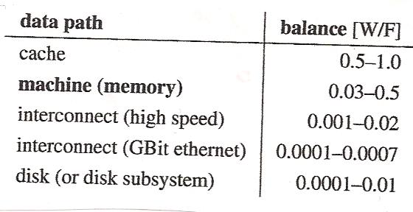
Typical balance values III

Slide 36
Example IV
Assume
Chip’s clock 3.0 GHz
Dual core processor
4 Flops/cycle/core
Memory bandwidth 10.6 Gbytes/sec
Balance ratio=0.55
Current microprocessors vary from 0.03 for standard cache based microprocessors to 0.5
for top vector processors.

Slide 37
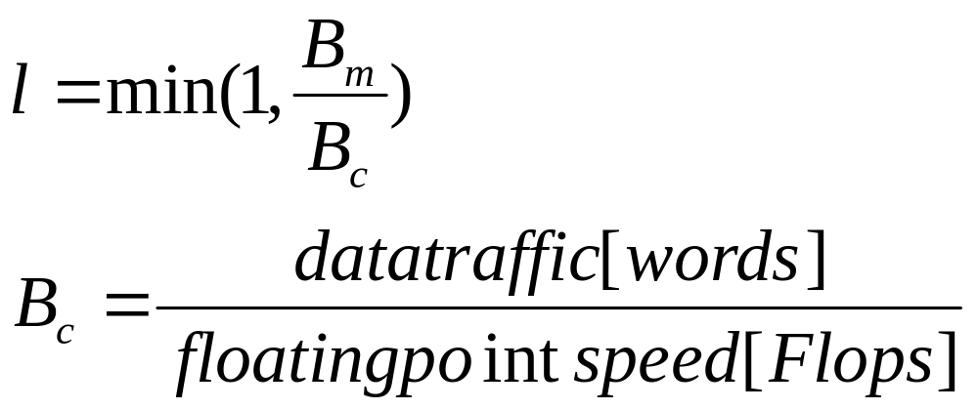
Lightspeed V
Definition of the lightspeed (the fraction of
the peak speed) computational intensity
The last value is called the code balance.
If lightspeed=1.0 the performance is not limited by bandwidth.

Slide 38
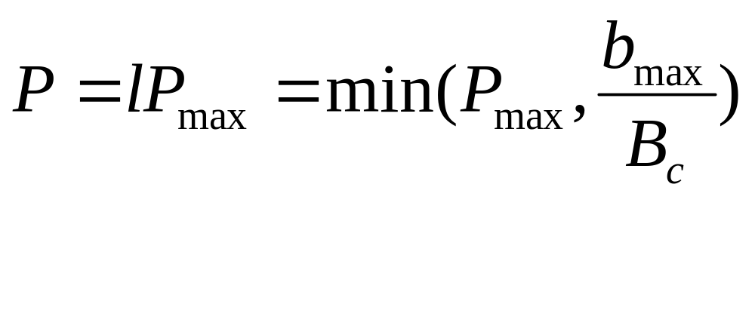
Assessing performance VI
Performance equation

Slide 39
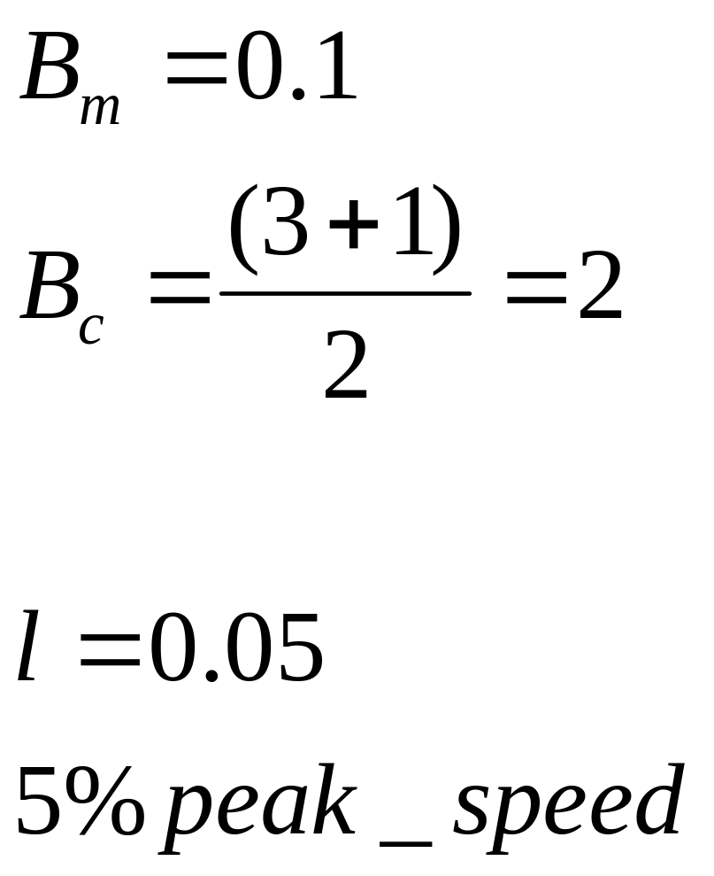
Example VII
Assume a kernel code being the vector triad:
for(int i=0;i<n;i++)
A[i]=B[i]+C[i]*D[i];
2 Flops per iteration
3 loads and 1 store

